Slide 1
ML, AI, NLP

Slide 2
Outline
Overview
AI
ML
NLP
LLM
Materials and Links
Goals

Slide 3
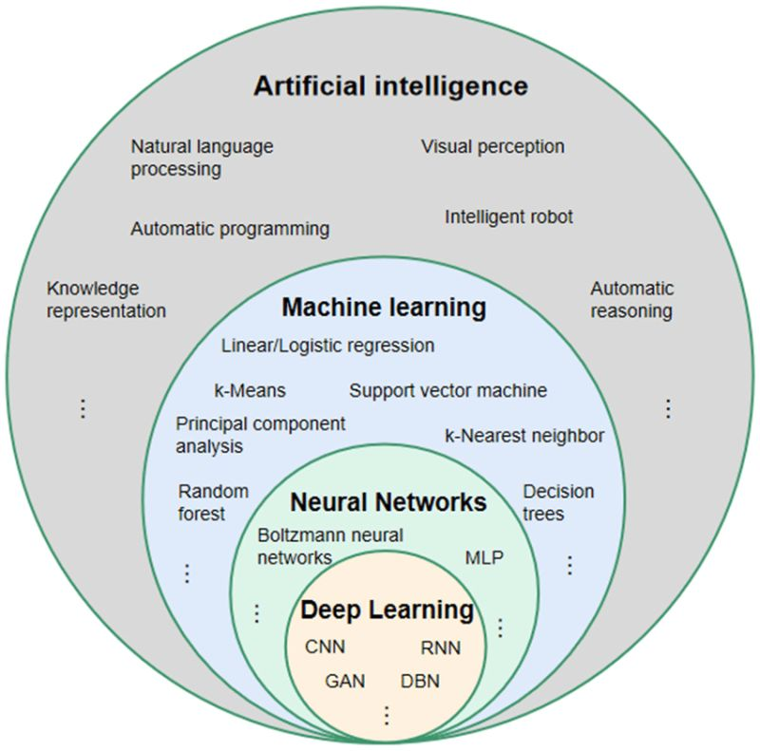
AI
Artificial Intelligence (AI) is a broader field that encompasses various techniques and methodologies to create intelligent systems that can perform tasks that typically require human intelligence. It includes both Machine Learning (ML) and Natural Language Processing (NLP) as subfields.

Slide 4
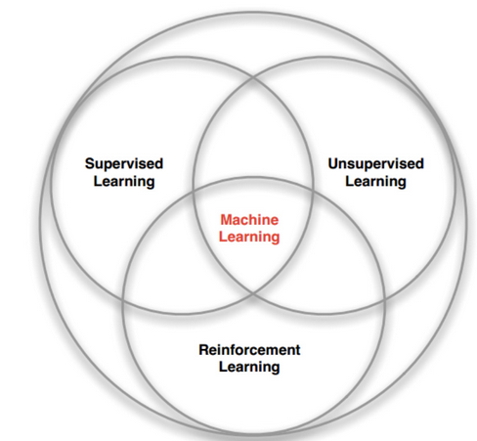
ML
Machine learning is a branch of artificial intelligence (AI) and computer science which focuses on the use of data and algorithms to imitate the way that humans learn, gradually improving its accuracy.
What does Learning mean? Short answer-> weight of our parameter or estimator
Type of learning
Supervised machine learning
Supervised learning, is defined by its use of labeled datasets to train algorithms to classify data or predict outcomes accurately. As input data is fed into the model, the model adjusts its weights until it has been fitted appropriately. This occurs as part of the cross validation process to ensure that the model avoids overfitting or underfitting. Some methods used in supervised learning include neural networks, linear regression, logistic regression, random forest, and support vector machine (SVM).
Unsupervised machine learning
Unsupervised learning, uses machine learning algorithms to analyze and cluster unlabeled datasets. These algorithms discover hidden patterns or data groupings without the need for human intervention. This method’s ability to discover similarities and differences in information make it ideal for exploratory data analysis, cross-selling strategies, customer segmentation, and image and pattern recognition. It’s also used to reduce the number of features in a model through the process of dimensionality reduction. Principal component analysis (PCA) and singular value decomposition (SVD) are two common approaches for this. Other algorithms used in unsupervised learning include neural networks, k-means clustering, and probabilistic clustering methods.
Semi-supervised learning
Semi-supervised learning offers a happy medium between supervised and unsupervised learning. During training, it uses a smaller labeled data set to guide classification and feature extraction from a larger, unlabeled data set. Semi-supervised learning can solve the problem of not having enough labeled data for a supervised learning algorithm. It also helps if it’s too costly to label enough data.
Reinforcement machine learning
Reinforcement machine learning is a machine learning model that is similar to supervised learning, but the algorithm isn’t trained using sample data. This model learns as it goes by using trial and error. A sequence of successful outcomes will be reinforced to develop the best recommendation or policy for a given problem.

Slide 5
Output:
Classification: The objective of this task is to determine which category the input belongs to. E.g. Default vs Non Default classification
Regression: the goal is to model the relationship between a numerical output and a number of inputs. The difference between regression and classification is the format of the output (continuous vs discrete and how we measure performance).
Prediction: Prediction is a special type of regression in which the objective is to foresee the future values of a given time series (no outcome specify).
Clustering: The target of clustering is to divide the input dataset into clusters.

Slide 6
How it Works
Decision Process: In general, machine learning algorithms are used to make a prediction or classification. Based on some input data, which can be labeled or unlabeled, your algorithm will produce an estimate about a pattern in the data.
An Error Function: An error function evaluates the prediction of the model. If there are known examples, an error function can make a comparison to assess the accuracy of the model.
A Model Optimization Process: If the model can fit better to the data points in the training set, then weights are adjusted to reduce the discrepancy between the known example and the model estimate. The algorithm will repeat this “evaluate and optimize” process, updating weights autonomously until a threshold of accuracy has been met.

Slide 7
Example
Linear regression: This algorithm is used to predict numerical values, based on a linear relationship between different values. For example, the technique could be used to predict house prices based on historical data for the area.
Logistic regression: This supervised learning algorithm makes predictions for categorical response variables, such as“yes/no” answers to questions. It can be used for applications such as classifying spam and quality control on a production line.
Clustering: Using unsupervised learning, clustering algorithms can identify patterns in data so that it can be grouped. Computers can help data scientists by identifying differences between data items that humans have overlooked.
Decision trees: Decision trees can be used for both predicting numerical values (regression) and classifying data into categories. Decision trees use a branching sequence of linked decisions that can be represented with a tree diagram. One of the advantages of decision trees is that they are easy to validate and audit, unlike the black box of the neural network.
Random forests: In a random forest, the machine learning algorithm predicts a value or category by combining the results from a number of decision trees.
Neural networks: Neural networks simulate the way the human brain works, with a huge number of linked processing nodes. Neural networks are good at recognizing patterns and play an important role in applications including natural language translation, image recognition, speech recognition, and image creation. (DL is NN with multiple Networks)

Slide 8
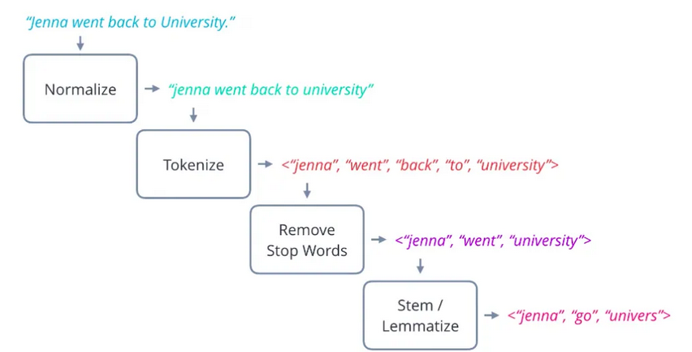
NLP
Natural language processing (NLP) is a subfield of artificial intelligence and computer science that focuses on the tokenization of data – the parsing of human language into its elemental pieces. By combining computational linguistics with statistical machine learning techniques and deep learning models, NLP enables computers to process human language in the form of text or voice data.

Slide 9
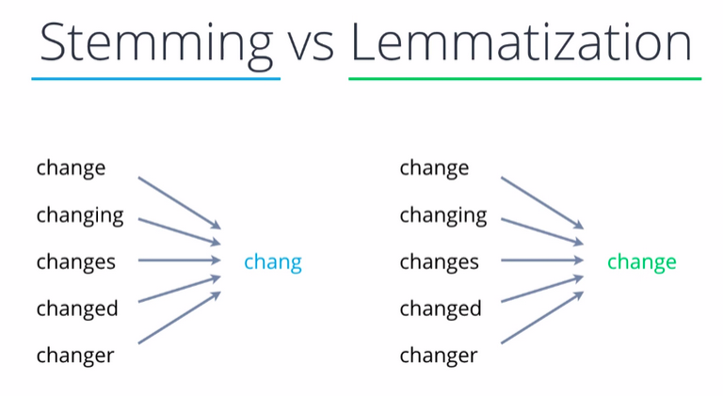
HOW IT WORKS
Tokenization
Also called word segmentation, tokenization is one of the simplest and most important techniques involved in NLP.
It’s a crucial preprocessing step in which a long string of text is broken down into smaller units called tokens. Tokens include words, characters, and subwords. They are the building blocks of natural language processing, and most NLP models process raw text on the token level.
Stemming & lemmatization
After tokenization, the next preprocessing step is either stemming or lemmatization. These techniques generate the root word from the different existing variations of a word.
Stemming and lemmatization are two different ways to try to identify a root word. Stemming works by removing the end of a word. This NLP technique may or may not work depending on the word. For example, it would work on “sticks,” but not “unstick” or “stuck.”
Lemmatization is a more sophisticated technique that uses morphological analysis to find the base form of a word, also called a lemma.

Slide 10
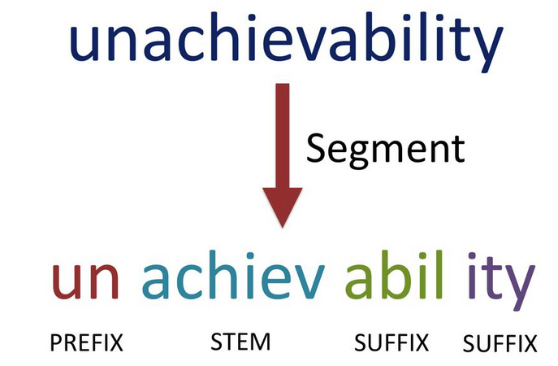
Morphological segmentation
Morphological segmentation is the process of splitting words into the morphemes that make them up. A morpheme is the smallest unit of language that carries meaning. Some words such as “table” and “lamp” only contain one morpheme.
But other words can contain multiple morphemes. For example, the word “sunrise” contains two morphemes: sun and rise. Like stemming and lemmatization, morphological segmentation can help preprocess input text.

Slide 11
Stop words removal
Stop words removal is another preprocessing step of NLP that removes filler words to allow the AI to focus on words that hold meaning. This includes conjunctions such as “and” and “because,” as well as prepositions such as “under” and “in.”
By removing these unhelpful words, NLP systems are left with less data to process, allowing them to work more efficiently. It isn’t a necessary step of every NLP use case, but it can help with things such as text classification.
Text classification
Text classification is an umbrella term for any technique used to organize large quantities of raw text data. Sentiment analysis, topic modeling, and keyword extraction are all different types of text classification. And we’ll talk about them shortly.
Sentiment analysis
Sentiment analysis, also known as emotion AI or opinion mining, is the process of analyzing text to determine whether it is generally positive, negative, or neutral.
As one of the most important NLP techniques for text classification, sentiment analysis is commonly used for applications such as analyzing user-generated content. It can be used on a variety of text types, including reviews, comments, tweets, and articles.
Parsing
Parsing is the process of figuring out the grammatical structure of a sentence, determining which words belong together as phrases and which are the subject or object of a verb. This NLP technique offers additional context about a text in order to help with processing and analyzing it accurately.
TF-IDF
TD-IDF, which stands for term frequency-inverse document frequency, is a statistical technique that determines the relevance of a word to one document in a collection of documents. It works by looking at two metrics: the number of times a word appears in a given document and the number of times the same word appears in a set of documents.

Slide 12
LLM
Language Models (LLM) are specific types of models used in NLP that are trained on large amounts of text data to generate coherent and contextually relevant text. LLMs are designed to understand and produce human-like language and are often built using advanced ML techniques, such as deep learning.
es, GPT (Generative Pre-trained Transformer) is a subset of Natural Language Processing (NLP). GPT is a specific type of language model that utilizes deep learning techniques, particularly transformers, to generate human-like text.
NLP encompasses a wide range of techniques and models that aim to understand, interpret, and generate human language using computational methods. It involves tasks such as text classification, sentiment analysis, machine translation, question answering, and text generation. GPT, as a language model, falls under the text generation aspect of NLP.
GPT models are trained on large amounts of text data, allowing them to learn patterns, context, and semantics of language. They have been successfully used in various NLP tasks, such as text completion, summarization, and dialogue systems. GPT models have demonstrated impressive language generation capabilities, making them valuable tools in natural language understanding and generation tasks within the broader field of NLP.

Slide 13
Materials
https://github.com/Hannibal046/Awesome-LLM#courses-about-llm
https://github.com/Mooler0410/LLMsPracticalGuide
Textbook: NLP: https://web.stanford.edu/~jurafsky/slp3/
The Elements of Statistical Learning: Data Mining, Inference, and Prediction.
Courses:
https://www.cs.princeton.edu/courses/archive/fall22/cos597G/
API:
https://github.com/humanloop/awesome-chatgpt

Slide 14
Goals and structure
Determine the Duration: Decide on the frequency of the lectur ( 1hr weekly or 1.5 hr bi-weekly) -> keep it focused and managebale
Define Learning Goals:
understanding the concepts of LLMs,
exploring potential use cases in MS,
gaining practical knowledge to leverage LLMs effectively.
Outline like:
Lecture 1: Introduction to Large Language Models and their applications in finance.
Lecture 2: Understanding the architecture and components of LLMs.
Lecture 3: Pre-training and fine-tuning of LLMs.
Lecture 4: Exploring language generation and text completion using LLMs.
Lecture 5: Leveraging LLMs for natural language understanding and sentiment analysis.
Lecture 6: Practical considerations for using LLMs in MS.
Lecture 7: Ethical considerations and potential limitations of LLMs.
Lecture 8: Case studies and practical examples of LLM applications in finance.
Prepare Materials
Practical Applications

Slide 15
Bonus (transformer)
A transformer is a deep learning architecture that has revolutionized various domains, particularly in natural language processing (NLP). It was introduced in the paper "Attention Is All You Need" by Vaswani et al. in 2017 and has since become a fundamental component of many state-of-the-art NLP models.
The transformer architecture is designed to overcome some limitations of recurrent neural networks (RNNs) and convolutional neural networks (CNNs) by leveraging self-attention mechanisms. It operates on sequences of data, such as words in a sentence or tokens in a document, without assuming any inherent order or sequential dependencies.
Key components of a transformer architecture include:
Self-Attention Mechanism: Self-attention allows the model to weigh the importance of different words/tokens in a sequence when processing each word/token. It captures contextual relationships between words/tokens in a more flexible and efficient manner compared to traditional recurrent approaches.
Encoder-Decoder Structure: Transformers often consist of an encoder and a decoder. The encoder takes an input sequence and generates a sequence of contextualized representations. The decoder, in turn, uses these representations to generate an output sequence.
Multi-Head Attention: Transformers use multiple attention heads to capture different types of information from the input sequence. Each head attends to different parts of the sequence, enabling the model to learn diverse representations.
Feed-Forward Neural Networks: Transformers employ feed-forward neural networks as a non-linear transformation layer following the self-attention mechanism. This layer helps capture more complex patterns and interactions in the data.
Transformers have demonstrated exceptional performance in various NLP tasks, including machine translation, text summarization, sentiment analysis, and named entity recognition. The Transformer architecture, with its ability to capture long-range dependencies and model context effectively, has become a cornerstone in the development of advanced NLP models.

Slide 16
Multimodal
Basically, multimodal LLMs combine text with other kinds of information, such as images, videos, audio, and other sensory data. Multimodality can solve some of the problems of the current generation of LLMs. Multimodal language models will also unlock ne
Transformers are especially useful because they can be trained through unsupervised learning on very large datasets of unlabeled text. They’re also scalable, which means their performance improves as they grow larger . applications that were impossible with text-only models.

